Slide 1

BoatU.S. is the nation’s largest organization of recreation boaters with over half a million Members

Slide 2

Cooperating Group Program
BoatU.S. offers 10% off Water Towing Services for boating organizations & yacht clubs
  Group members can join or renew their BoatU.S. Membership for $25 plus 10% off Unlimited Water Towing packages.
  BoatU.S. asks that participants help educate their members about BoatU.S.
To join BoatU.S., visit BoatUS.com/Join and enter your club’s unique source code or BoatU.S. code GAXXXXXX in the “BoatUS Cooperating Group Number” field
Existing Members can add their club’s unique source code or BoatU.S. code GAXXXXXX to their Membership by emailing Membership@BoatUS.com or entering it in the “BoatUS Coop Group #” field when renewing their Membership on BoatUS.com/Renew
Customers can also call BoatUS at 800-395-2628 to join or renew their Membership

Slide 3
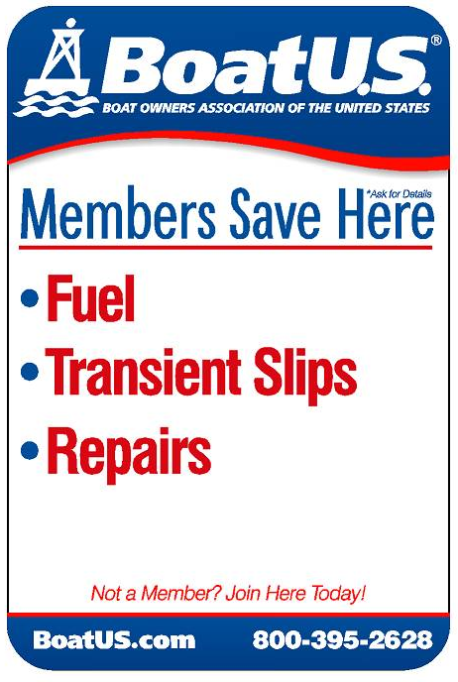


BoatU.S. Membership Benefits
Water Towing & Trailer Towing Service
Marine Insurance
Discounts on fuel, slips, repairs & more at over 1,200 boating and fishing businesses
Shopping rewards at West Marine
Boat Graphics & Lettering
BoatU.S. Magazine subscription
Boater representation
Boat Finance
Free MMSI Number
Notes:
Unlimited Towing & Trailering Options – added on to gold Membership only
Broad coverage Marine Insurance Policies – yacht to PWC
Discounts at boating businesses nationwide – Cooperating Marinas – over 1000 businesses- fuel, transient slips, repairs, mobile mechanic, restaurants, etc.
Award winning BoatU.S. Magazine – 6 times per year CLICK - coupon
Government Representation on behalf of boaters – local and national – lobbyists on Capitol Hill
Highest level of rewards at West Marine -4% back / $10 certificate

Slide 4
Annual Pricing for BoatU.S. Cooperating Groups
Basic Membership ($30 retail)
$25
Unlimited Freshwater Towing Membership ($99 retail)
BoatU.S. pays 100% for on-the-water towing, jump starts, fuel delivery & soft ungroundings and 50% for dock-to-dock tows for repairs, on inland lakes & rivers
$91
Unlimited Saltwater Towing Membership ($165 retail)
BoatU.S. pays 100% for on-the-water towing, jump starts, fuel delivery & soft ungroundings and 50% for dock-to-dock tows for repairs, on all bodies of water
$151
Unlimited Gold Towing Membership ($200 retail)
All the benefits of Unlimited Saltwater Towing Membership plus BoatU.S. pays 100% for dock-to-dock tows for repairs
$183
Notes:
Prices lowered nationwide earlier this year. $72 if your customers are only boating on lakes and rivers in TX. If going where water becomes brackish, the $149 Saltwater towing membership is required. Yes, Saltwater also covers freshwater. Prices shown also reflect 50% of Membership dues. (Retail $30)
Gold is only needed for dock-to-dock tows, so ask your customer where they keep their boat. If it is on a lift behind their house and they do not have a mobile mechanic or can get the boat on a trailer to a repair shop, this is a good option for them.

Slide 5
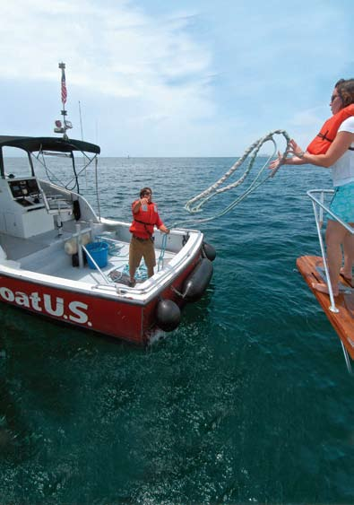
BoatU.S. Water Towing Service
600+ TowBoatU.S. towboats servicing over 300+ ports
  Find nearby locations on BoatUS.com/Map or use the BoatU.S. App
24/7 Dispatch
  BoatU.S. App (BoatUS.com/App)
  Call 800-391-4869
  Hail “TowBoatU.S.” on VHF 16
Water Towing Assistance for:
  Towing back to port
  Jumpstarts
  Fuel delivery
  Soft ungroundings
  Engine failure
Notes:
Unlimited Towing & Trailering Options – added on to gold Membership only
Broad coverage Marine Insurance Policies – yacht to PWC
Discounts at boating businesses nationwide – Cooperating Marinas – over 1000 businesses- fuel, transient slips, repairs, mobile mechanic, restaurants, etc.
Award winning BoatU.S. Magazine – 6 times per year CLICK - coupon
Government Representation on behalf of boaters – local and national – lobbyists on Capitol Hill
Highest level of rewards at West Marine -4% back / $10 certificate

Slide 6
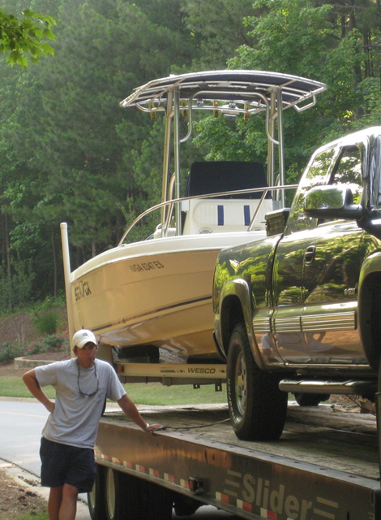
BoatU.S. Road Towing Service
On the road assistance for both your trailer and the towing vehicle while trailering your boat for $15 annually
24/7 Dispatch
  BoatU.S. App (BoatUS.com/App)
  Call 800-391-4869
  Hail “TowBoatU.S.” on VHF 16
Roadside Towing Assistance
  100 miles of roadside towing assistance for the
  boat trailer and tow vehicle
  Flat tires
  Jump starts
  Lockout service
Notes:
Unlimited Towing & Trailering Options – added on to gold Membership only
Broad coverage Marine Insurance Policies – yacht to PWC
Discounts at boating businesses nationwide – Cooperating Marinas – over 1000 businesses- fuel, transient slips, repairs, mobile mechanic, restaurants, etc.
Award winning BoatU.S. Magazine – 6 times per year CLICK - coupon
Government Representation on behalf of boaters – local and national – lobbyists on Capitol Hill
Highest level of rewards at West Marine -4% back / $10 certificate

Slide 7
Learn More About BoatU.S.
Visit BoatUS.com
Download the free BoatU.S. mobile app at BoatUS.com/App
Visit BoatUS.com/Map
  Find the nearest BoatU.S. towing ports, Partner Network participants, Life Jacket Loaner Program locations and West Marine stores
Notes:
Unlimited Towing & Trailering Options – added on to gold Membership only
Broad coverage Marine Insurance Policies – yacht to PWC
Discounts at boating businesses nationwide – Cooperating Marinas – over 1000 businesses- fuel, transient slips, repairs, mobile mechanic, restaurants, etc.
Award winning BoatU.S. Magazine – 6 times per year CLICK - coupon
Government Representation on behalf of boaters – local and national – lobbyists on Capitol Hill
Highest level of rewards at West Marine -4% back / $10 certificate

